Slide 1

Energy-efficient system providing superior IAQ
3fficiency: pinnacle, NEUTON and chilled beams

Slide 2

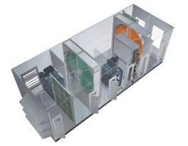
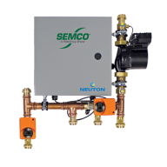
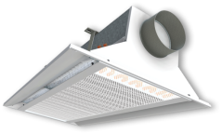
3fficiency system components
3fficiency™ is the “Pinnacle” of chilled beam systems. The 3 components included in the system package are:
Pinnacle™ Dedicated Outside Air System (DOAS),
NEUTON™ Chilled Beam Pump Module, and
SEMCO Active Chilled Beam line.
The NEUTON pump module manages the water system to allow for a building level occupant control that is superior to all other systems.

Slide 3
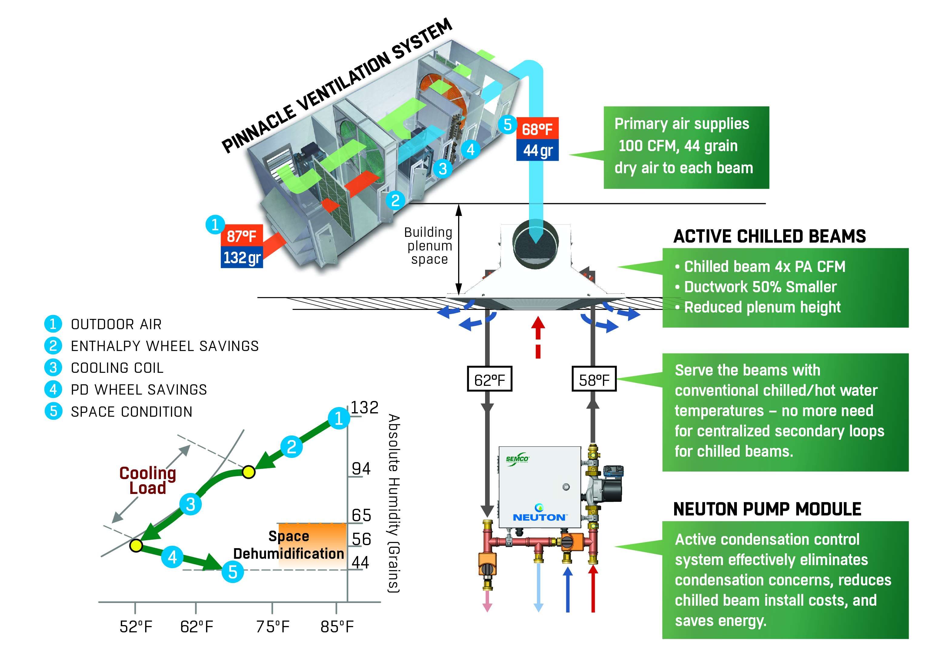
3fficiency system

Slide 4
System Configuration
Feature set includes:
1. The outside air portion of the system will be treated by a Pinnacle
2. Each zone has a combination of:
a. A chilled beam
b. Diffuser
c. Return grill
d. Temp and humidity sensor
e. Opt 2 way valve (if multiple zones are required)
3. Each 1-5 zones will have a NEUTON (See Figure 1)
4. Controls are all native Bacnet

Slide 5

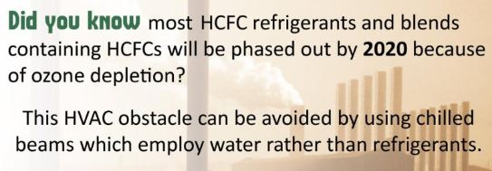
Direct Replacement for VRF
3fficiency can directly replace Variable Refrigerant Flow (VRF)
Provides even more savings through the use of a water to water chiller and using the condenser water as the hot water for the system
No more concerns with ASHRAE 15, refrigerant leaks, or large electrical wire runs
A whole building Variable WATER Flow System!

Slide 6
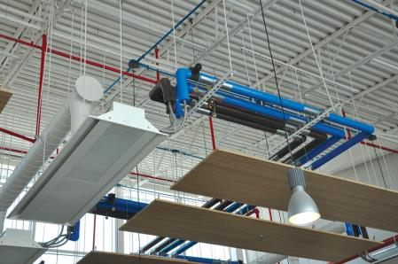

CHILLED BEAMS
Active and Passive

Slide 7
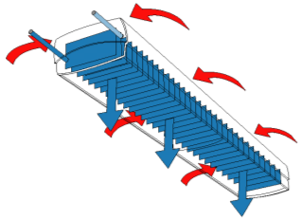



Passive Chilled Beams
The << engine >> is the gravity and the density difference between the cold air and the warm air
Only cooling mode
The air diffusion isn’t controlled and there are risks of draft below the chilled beam
Passive chilled beams are used only for an additional source of cooling for a specific need.

Slide 8

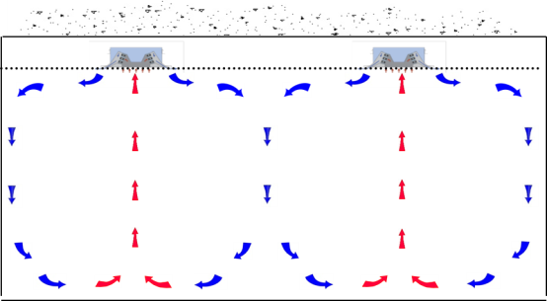
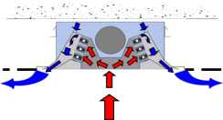
Active Chilled Beams
The « engine » is the induction created by the adjustable slots.
Cooling and heating mode.
The fresh air is supplied through the chilled beam.
Mixing air diffusion into the room so the air velocity is controlled.
Active chilled beams provide heating, cooling and ventilation with high comfort.

Slide 9
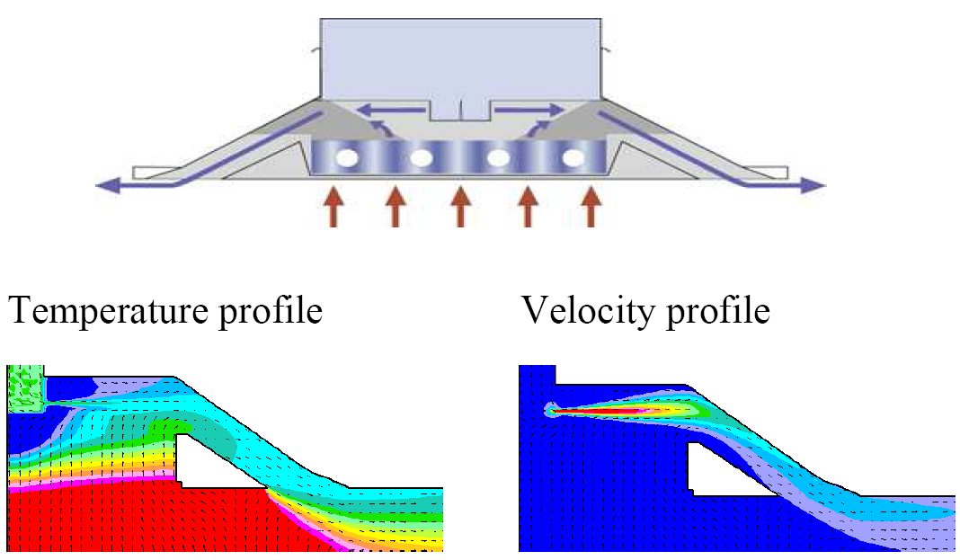
Active Chilled Beams

Slide 10


Comfort Control
Adjustable induction on site
Different air distribution available:
One way distribution
Two way distribution
Asymmetric air diffusion
Chilled beam capacity can be increased or decreased by slot adjustment
No tools required
50%
50%
80%
20%
0%
100%

Slide 11
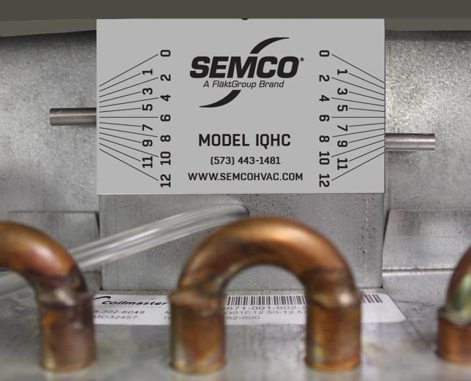
IQHC Air Slider Label

Slide 12
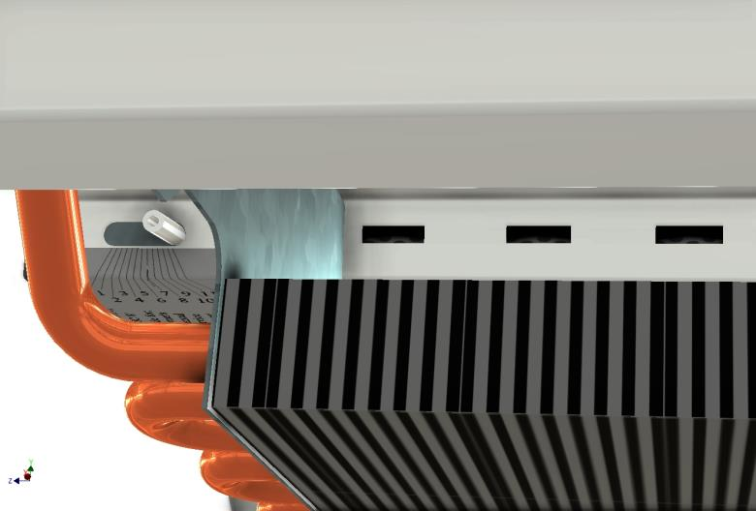
IQHC Air Slider Open

Slide 13
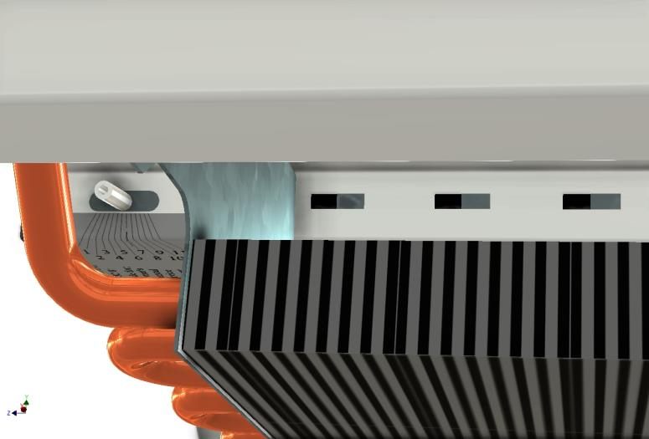
IQHC Air Slider Half Open

Slide 14
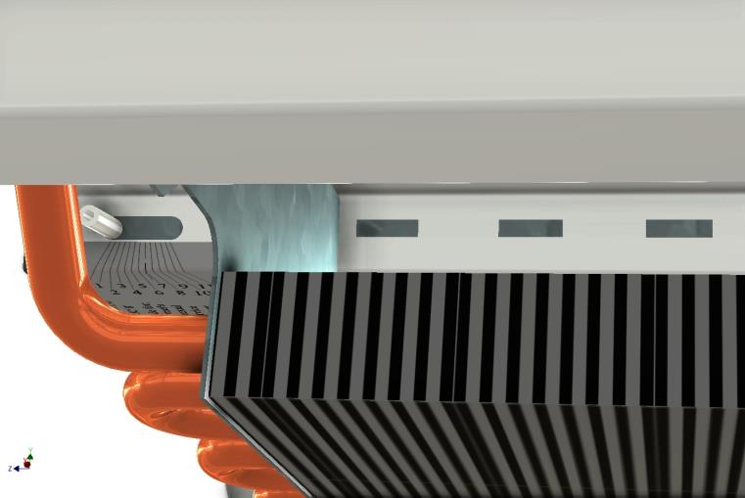
IQHC Air Slider Closed

Slide 15
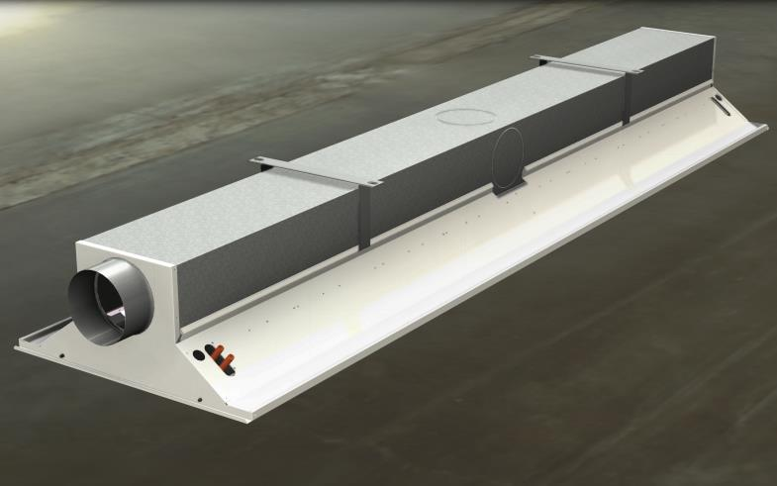
Universal Beams

Slide 16
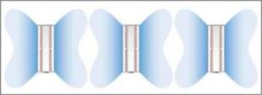
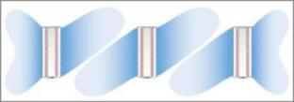
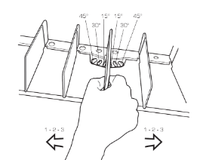
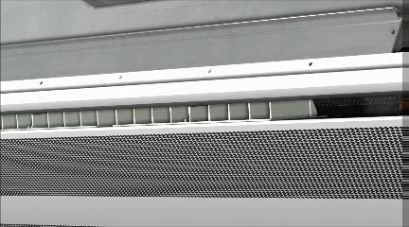
Flow Pattern Control System
Plastic blades to adjust air diffusion & throw length Angles: 0°- 15°- 30°- 45°
Modules of 2 feet to get different flow pattern
Manual adjustment from room to room, no tools required
Flexibility in building design
Increased comfort level
No tools required

Slide 17
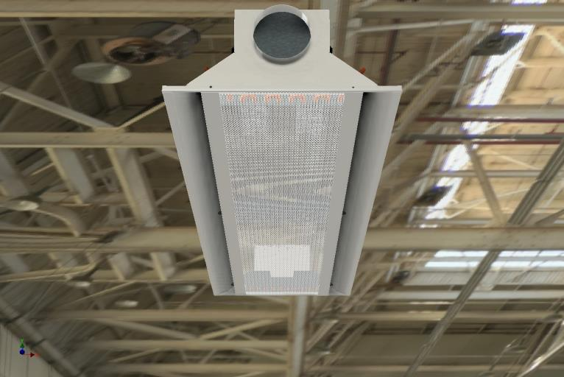
Bottom Closed

Slide 18
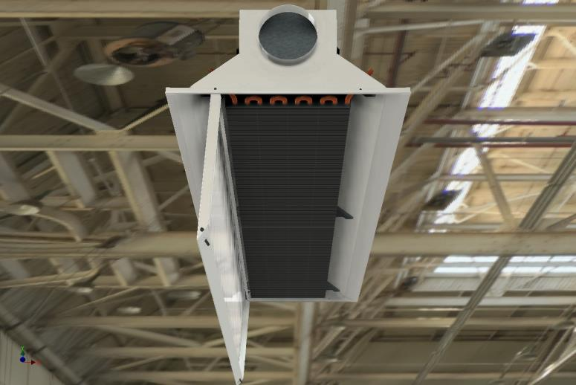
Bottom Open

Slide 19
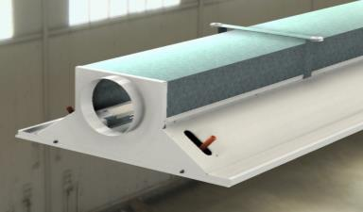
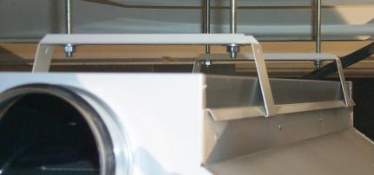
Accessories for Installation
Fastening Brackets for both types of installation:
Free hanging installation
False ceiling installation
Easier installation
Installation cost reduction
Faster installation
Attachment QFAZ-18
Attachment CB-IQHC-24

Slide 20
Chilled Beams Benefits
Experience
Applied in Europe for more than 3 decades
Applied in the US more than 10 years
SEMCO manufactured in the United States for more than 5 years
Indoor Air Quality
Increased ventilation to each space (all applications)
Better air distribution (circulation) within the space
Lower sound levels than almost all HVAC systems
Energy Savings
Reduced fan horsepower
Load matching (only use space cooling if required)
Higher temperature chilled water (increased chiller efficiency)
First Cost Savings
Reduced duct size
Reduced interstitial space
Smaller air handlers, plant rooms

Slide 21
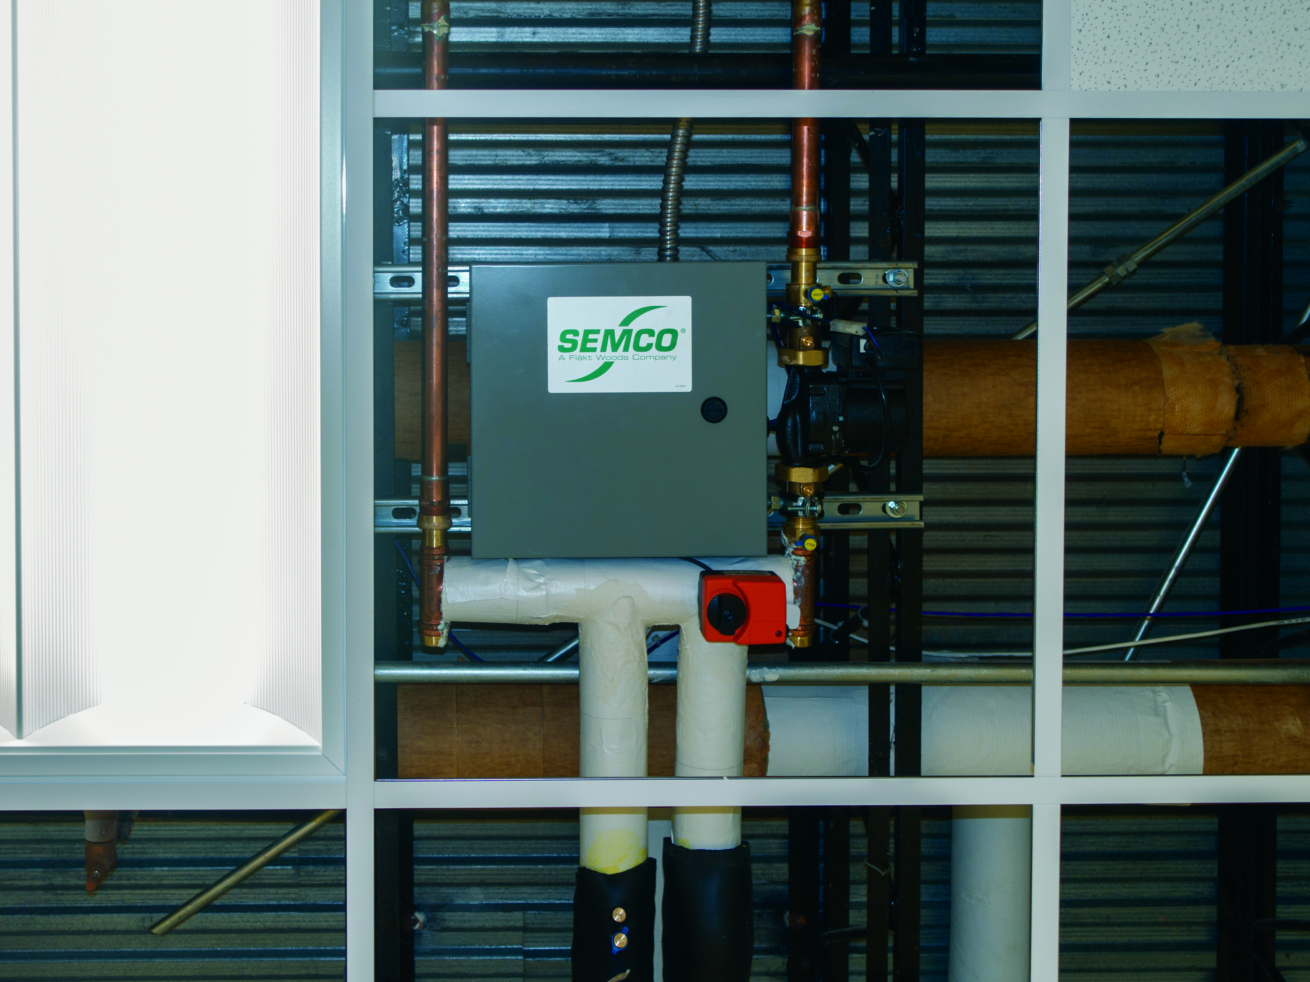
NEUTON
Controlled Chilled Beam Pump Module
U.S. patent number 9,625,222

Slide 22
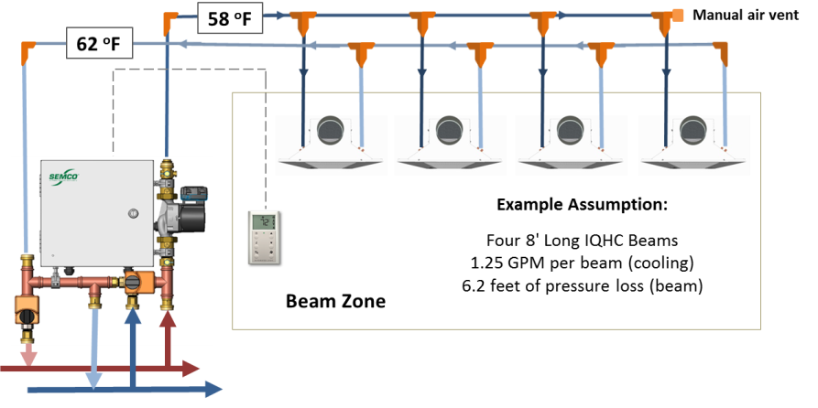

Concept
42 ºF

Slide 23
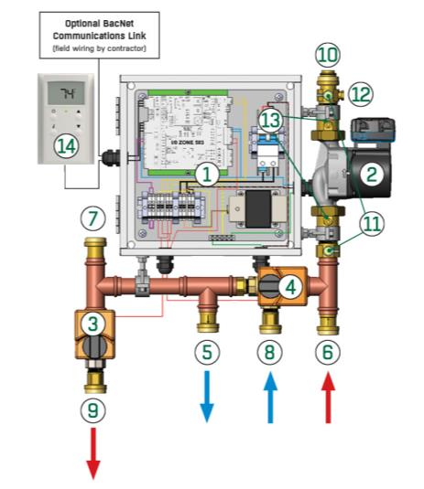
Component Parts
Integrated electrical, DDC controls panel
Electronically Commutated Motor (ECM) high efficiency, variable speed pump
Hot water control valve
Chilled water control valve
Chilled water return
Hot water supply
Zone loop return connection
Chilled water supply
Hot water return
Zone supply water connection
Pete’s plugs for pressure and flow measurement
Zone supply water thermistor
Pump Isolation Valves
ZS Pro Sensor Zone Controller
NEUTON Chilled Beam Pump Module

Slide 24
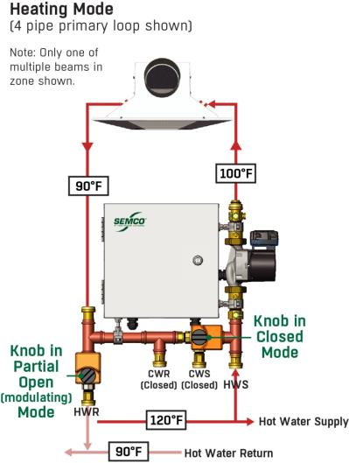
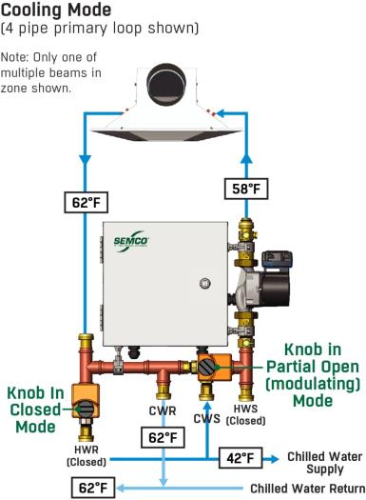
How It Works: (4 pipe primary loop)

Slide 25
NEUTON Benefits
New Construction:
Reduction of installation cost by 30% and more
Use of conventional water (chilled/hot)
Simplifies installation, and includes zone level controls
Active condensation control
Reduces pump energy and addresses load matching
Improves response to occupied/unoccupied conditions
PATENTED DESIGN: U.S. patent number 9,625,222
Existing Construction:
Re-utilize existing hot water / chilled water systems piping and central plant
Alleviates concern regarding vapor barrier (or lack thereof)
True energy savings compared to VRF option
Similar design
Reduces refrigerant

Slide 26

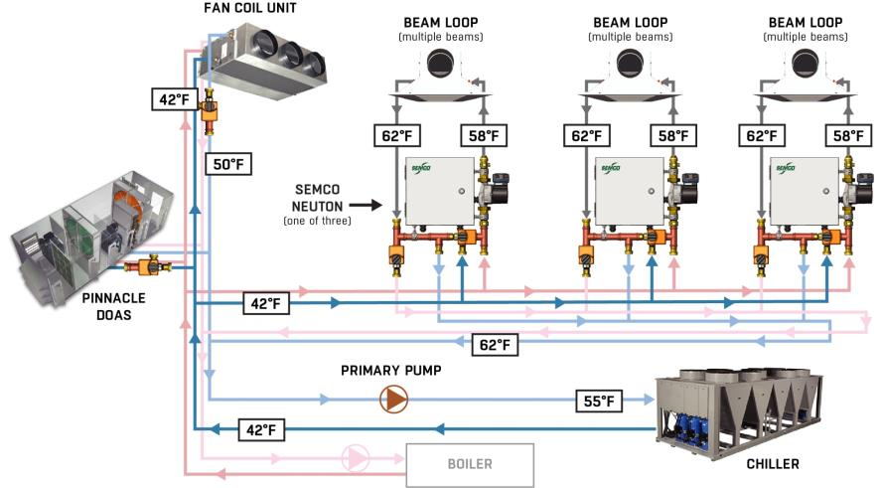
Traditional 4 Pipe Approach

Slide 27
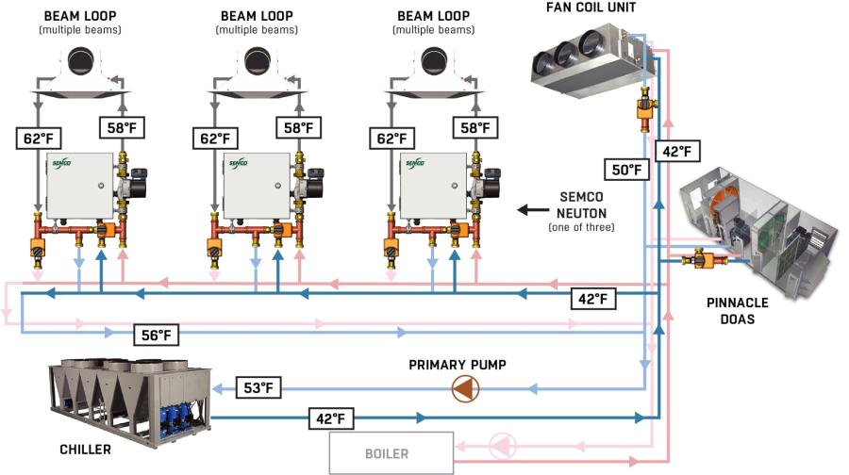
Unconventional 2 Pipe Approach

Slide 28
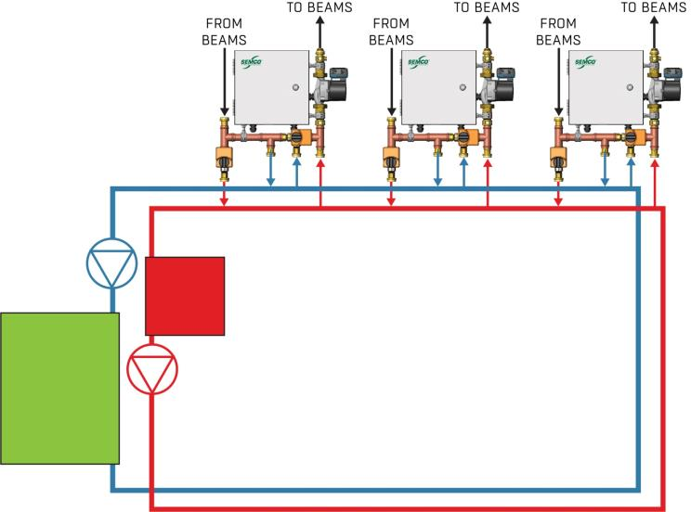
Main Loop View
CHILLED WATER PUMP
PUMPS SIZED FOR MAIN LOOP WITH REGARD TO TOTAL GPM REQUIRED AND PRESSURE VARIABLE SPEED OF PUMP CONTROLELD BASED ON THERMOWELL DESIGNATED DELTA TEMP
WATER IN BOTH LOOPS HAVE TO HAVE SAME CHEMISTRY
HOT WATER BOILER
HEAT EXCHANGER TO ISOLATE BEAM LOOP FROM CENTRAL PLANT
HOT WATER PUMP

Slide 29
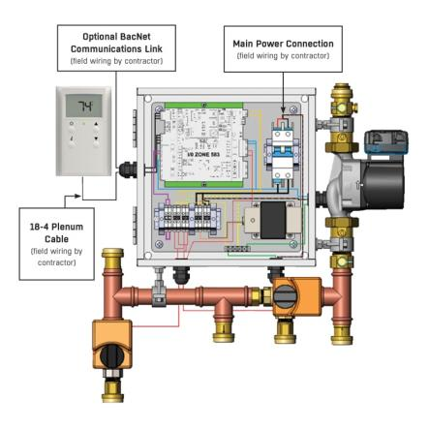
Greatly simplify Design and Installation Process
Factory wired/tested
Zone Pump
Water temp sensor
Control Valve
Electrical/controls
Electrical Field connections required
Smart sensor
Main power (208/230 – 1 Ph)
BAS (if applicable)
Water connections
6 pipe connections
Swivel half-union adapters
Designed for std 1” male fitting

Slide 30
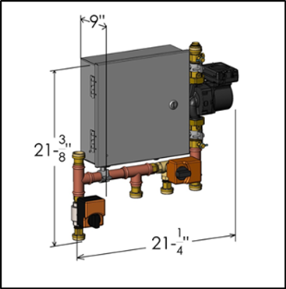
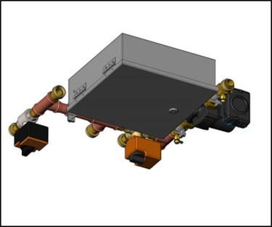
Vertical or Horizontal Mounting Accommodated
Notes:
NEUTON can be mounted in several positions as long as the pump shaft remains horizontal (as shown above)
Adequate space must be allocated of opening the hinged panel door and accessing the DDC control board and other components

Slide 31
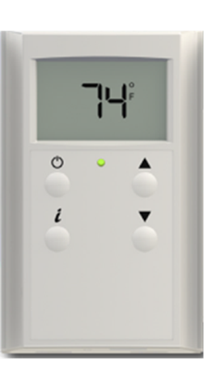
Room Smart Sensor
Features
Full digital display
Communicates with NEUTON via BACnet
Wall sensor includes:
Temperature
Relative Humidity
CO2 (optional)

Slide 32
Reduced First Cost Comparison
Summary of Zone Performance/Cost Analysis: Current State-of-the-Art 4-Pipe Approach vs. NEUTON and 2-Pipe Approach
Estimated Installed Cost | SOA 4 Pipe Coils | NEUTON 4 Pipe Coils | NEUTON 2 Pipe Coils
Primary Loop | $65,000 | $23,840 | $10,450
Zone Loops, Beams, Controls, NEUTON | $68,230 | $77,300 | $77,300
Total Installed Cost ⁽¹⁾ | $133,230 | $101,140 | $87,750
Reduction from SOA Baseline (percentage) | 0% | 24% | 34%
Reduction from SOA Baseline ($/sq.ft.) | $0 / sq.ft. | $2.10 / sq.ft. | $3.00 / sq.ft.
Note 1: Includes all installed components except ductwork and Pinnacle DOAS equipment and installation

Slide 33

System integration
PINNACLE – NEUTON - CHILLED BEAMS

Slide 34
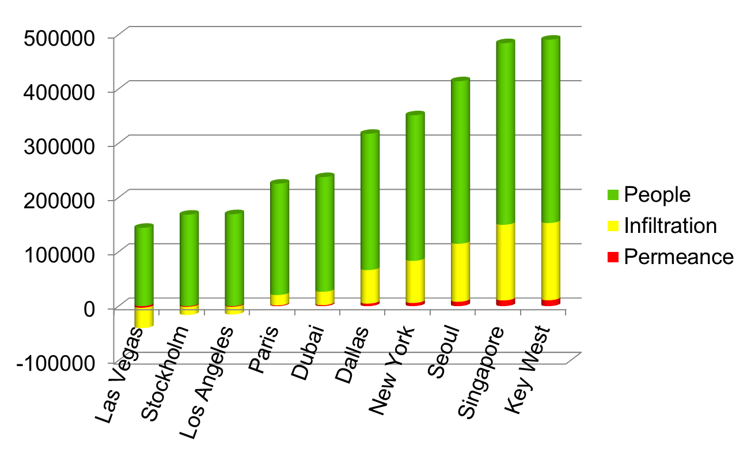
Space Humidity Remains Regardless of Location
Based on 0.04% ASHRAE Peak Dry Bulb Design
BTUH

Slide 35
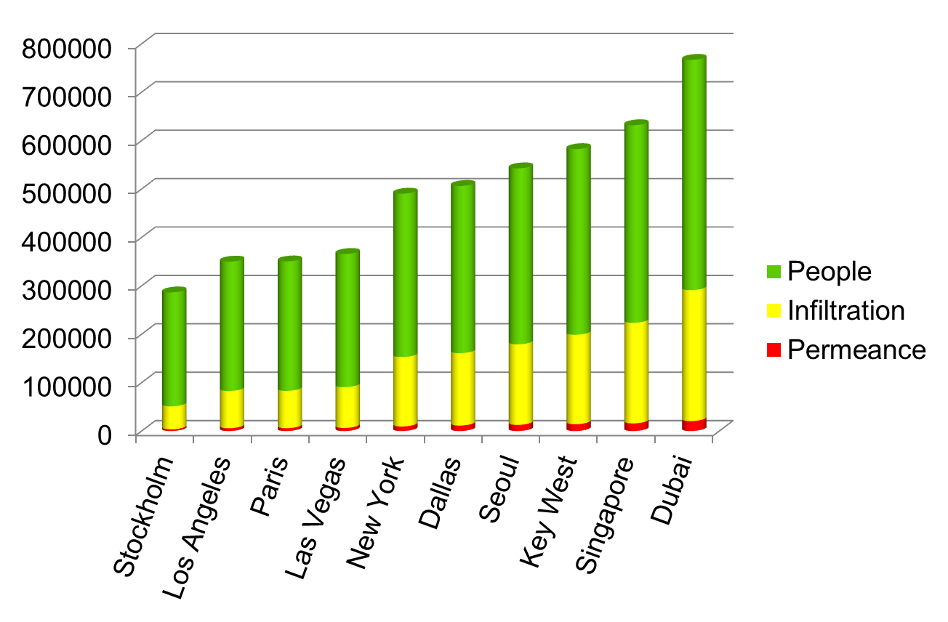
Space Humidity Remains Regardless of Location
Based on 0.04% ASHRAE Peak Dewpoint Design
BTUH

Slide 36
What Determines Minimum Primary Airflow?
ASHRAE 62 minimum ventilation requirement
Minimum to satisfy space latent load
Minimum to satisfy space sensible load
Make-up air requirement
*Laboratory, Kitchen Exhaust Make-up, Etc.

Slide 37
How Supply Dewpoint Effects Primary Airflow
Maintaining 50% space relative humidity at 75F db
Based on 3 ton space latent load

Slide 38
Pinnacle Dual Wheel DOAS - Review
SEMCO TE
SEMCO PD
Total Energy Wheel
Passive DH Wheel
Outdoor Air
(Pressure loss)
Cooling Coil
(Pressure loss)
Supply Air
0.83 in.wg.
0.82 in.wg.
11,813 CFM
10,818 CFM
10,818 CFM
10,000 CFM
95.0°db
/
78.0°wb
77.3°db
/
68.3°wb
52.5°db
/
52.1°wb
61.2°db
/
52.5°wb
118.1 gr
89.6 gr
57.2 gr
45.0 gr
41.4 BTU/lb
32.6 BTU/lb
21.5 BTU/lb
21.8 BTU/lb
10,813 CFM
9,818 CFM
9,000 CFM
89.3°db
/
75.3°wb
67.6°db
/
62.9°wb
75.0°db
/
62.5°wb
109.9 gr
78.6 gr
65.0 gr
38.7 BTU/lb
28.5 BTU/lb
28.3 BTU/lb
TE Purge/Seals (995 CFM)
PD Purge/Seals (818 CFM)
0.793
0.72 in.wg.
Exhaust Air
TE Effectiveness
(Pressure loss)
Return Air
0.73 in.wg.
(PD Wheel Speed
.25 RPM)
(Pressure loss)

Slide 39
Summarizing Primary Air and Humidity Concern
Traditional beam system approach utilizes higher dewpoint/colder air
Primary benefit of chilled beam system is horsepower reduction
To maximize energy benefit, minimize primary air
Lower the airflow, the lower the dewpoint required.
Application type impacts approach – 3fficiency system can be adjusted to suit the application and amount of outdoor air required

Slide 40
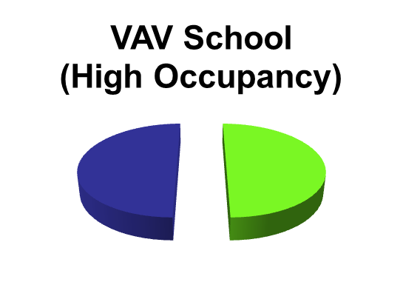
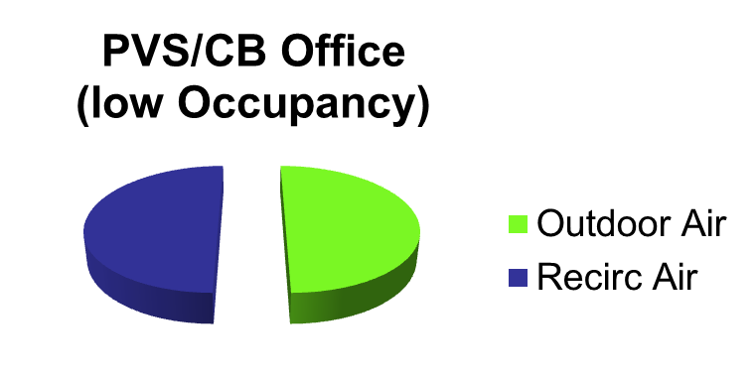
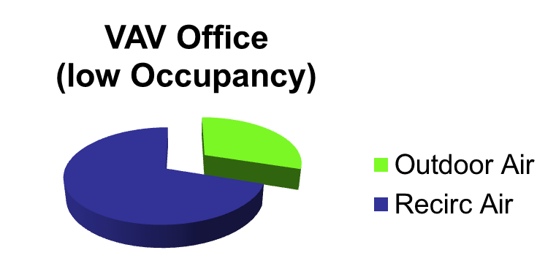
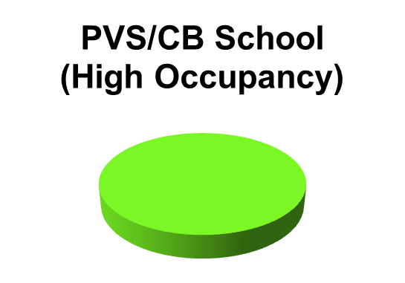
Occupancy Impacts Primary Air
Chilled Beams require ½ the airflow of a traditional VAV system design

Slide 41
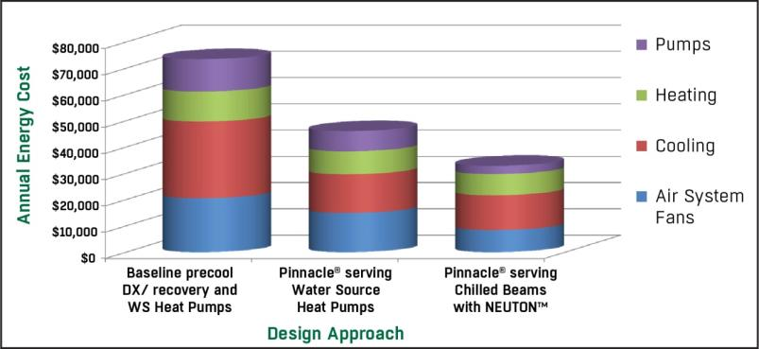
Energy Modeling: Systems Compared
Energy modeling completed for an actual High School project comparing three design approaches which highlights the significant fan and pump energy savings offered by the 3fficiency system.

Slide 42
System Integration Summary
Geography doesn’t eliminate humidity concerns
Lower dewpoints requires lower primary airflow requirement
A Pinnacle unit uses the lowest dewpoint with the least energy
Primary Air is determined by
ASHRAE 62
Minimum Dehumidification
Minimum Sensible
Make up air requirement
Adjustable nozzles makes test and balance easier
A chilled beam system can save more than 50% of the building’s HVAC energy
3fficiency uses an average of 70% less pump energy to achieve better comfort than traditional equipment

Slide 43
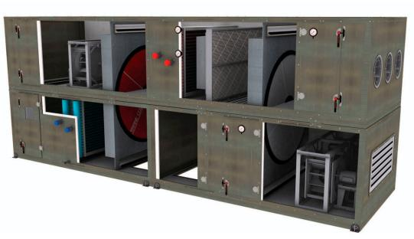
competition
DUAL WHEEL DEHUMIDIFIERS

Slide 44
Competitor #1 – Peak Dry Bulb
50%
Outdoor Air
Total Energy Wheel
Passive DH Wheel
(Pressure loss)
(Pressure loss)
0.80 in.wg.
1.27 in.wg.
11,366 CFM
10,538 CFM
10,538 CFM
10,538 CFM
95.0°db / 78.0°wb
81.3°db
/
67.7°wb
81.3°db
/
67.7°wb
77.3°db
/
68.5°wb
118.1 gr
80.2 gr
80.2 gr
90.8 gr
41.4 BTU/lb
32.1 BTU/lb
32.1 BTU/lb
32.8 BTU/lb
Cooling Coil
10,366 CFM
9,000 CFM
10,000 CFM
10,538 CFM
93.5°db / 76.0°wb
75.0°db
/
62.5°wb
57.0°db
/
50.7°wb
51.0°db
/
51.0°wb
107.9 gr
65.0 gr
45.0 gr
55.6 gr
38.5 BTU/lb
28.2 BTU/lb
20.7 BTU/lb
20.8 BTU/lb
0.797
1.27 in.wg.
Exhaust Air
TE Effectiveness
Return Air
Supply Air
(Pressure loss)
0.70 in.wg.
(PD Wheel Speed RPM) – 0.61
(Pressure loss)

Slide 45
Competitor #1 – Part Load
61%
Outdoor Air
Total Energy Wheel
Passive DH Wheel
(Pressure loss)
(Pressure loss)
0.80 in.wg.
1.27 in.wg.
11,366 CFM
10,538 CFM
10,538 CFM
10,538 CFM
70.0°db
/
70.0°wb
74.5°db
/
65.1°wb
74.5°db
/
65.1°wb
71.8°db
/
65.8°wb
110.8 gr
78.2 gr
78.2 gr
85.6 gr
34.1 BTU/lb
30.1 BTU/lb
30.1 BTU/lb
30.6 BTU/lb
Cooling Coil
10,366 CFM
9,000 CFM
10,000 CFM
10,538 CFM
73.4°db
/
69.4°wb
75.0°db
/
62.5°wb
55.7°db
/
51.0°wb
51.0°db
/
51.0°wb
102.1 gr
65.0 gr
48.2 gr
55.6 gr
33.6 BTU/lb
28.2 BTU/lb
20.8 BTU/lb
20.8 BTU/lb
0.797
1.27 in.wg.
Exhaust Air
TE Effectiveness
Return Air
Supply Air
(Pressure loss)
0.70 in.wg.
(PD Wheel Speed RPM) – 0.61
(Pressure loss)

Slide 46
Competitor #1 – Part Load
61%
Solution #1
Colder Coil
Outdoor Air
Total Energy Wheel
Passive DH Wheel
(Pressure loss)
(Pressure loss)
0.80 in.wg.
1.27 in.wg.
11,366 CFM
10,538 CFM
10,538 CFM
10,538 CFM
70.0°db
/
70.0°wb
74.5°db
/
65.1°wb
74.5°db
/
65.1°wb
71.8°db
/
65.8°wb
110.8 gr
78.2 gr
78.2 gr
85.6 gr
34.1 BTU/lb
30.1 BTU/lb
30.1 BTU/lb
30.6 BTU/lb
Cooling Coil
10,366 CFM
9,000 CFM
10,000 CFM
10,538 CFM
73.4°db
/
69.4°wb
75.0°db
/
62.5°wb
55.7°db
/
51.0°wb
51.0°db
/
51.0°wb
102.1 gr
65.0 gr
48.2 gr
55.6 gr
33.6 BTU/lb
28.2 BTU/lb
20.8 BTU/lb
20.8 BTU/lb
0.797
1.27 in.wg.
Exhaust Air
TE Effectiveness
Return Air
Supply Air
(Pressure loss)
0.70 in.wg.
(PD Wheel Speed RPM) – 0.61
(Pressure loss)
PROBLEM WILL BE COLDER DISCHARGE

Slide 47
Competitor #1 – Part Load
Solution #2
Add Heating
Outdoor Air
Total Energy Wheel
Active DH Wheel
(Pressure loss)
Heating Coil
(Pressure loss)
0.80 in.wg.
1.27 in.wg.
11,366 CFM
10,538 CFM
10,538 CFM
10,538 CFM
70.0°db
/
70.0°wb
74.5°db
/
65.1°wb
81.3°db
/
67.3°wb
77.3°db
/
68.0°wb
110.8 gr
78.2 gr
78.2 gr
88.2 gr
34.1 BTU/lb
30.1 BTU/lb
31.8 BTU/lb
32.4 BTU/lb
Cooling Coil
10,366 CFM
9,000 CFM
10,000 CFM
10,538 CFM
73.4°db
/
69.4°wb
75.0°db
/
62.5°wb
57.0°db
/
50.6°wb
51.0°db
/
51.0°wb
102.1 gr
65.0 gr
44.6 gr
55.6 gr
33.6 BTU/lb
28.2 BTU/lb
20.6 BTU/lb
20.8 BTU/lb
0.797
1.27 in.wg.
Exhaust Air
TE Effectiveness
Return Air
Supply Air
(Pressure loss)
0.70 in.wg.
(PD Wheel Speed RPM) – 0.61
(Pressure loss)

Slide 48
Competitor #2 – Peak Dry Bulb
18%
Outside air jumps over return air path
Total Energy Wheel
Active DH Wheel
Outdoor Air
(Supply Side Pressure)
Heating Coil
(Pressure loss)
Exhaust Air
0.80 in.wg.
1.27 in.wg.
11,366 CFM
9,828 CFM
9,828 CFM
10,366 CFM
95.0°db
/
78.0°wb
93.5°db
/
76.0°wb
125.0°db
/
67.3°wb
108.0°db
/
82.9°wb
118.1 gr
107.9 gr
107.9 gr
130.9 gr
41.4 BTU/lb
39.5 BTU/lb
31.8 BTU/lb
46.7 BTU/lb
10,538 CFM
9,000 CFM
10,538 CFM
10,000 CFM
81.3°db
/
67.7°wb
75.0°db
/
62.5°wb
58.0°db
/
57.0°wb
77.0°db
/
58.8°wb
80.2 gr
65.0 gr
68.0 gr
45.0 gr
32.1 BTU/lb
28.2 BTU/lb
24.5 BTU/lb
25.5 BTU/lb
0.797
Return Air
1.27 in.wg.
Supply Air
TE Effectiveness
Cooling Coil
(Pressure loss)
0.70 in.wg.
(PD Wheel Speed RPM) – 0.61
(Return Side Pressure)
Supply Temp Adds Load to Space

Slide 49
Competitor #2 – Part Load
30%
Total Energy Wheel
Active DH Wheel
Outdoor Air
(Supply Side Pressure)
Heating Coil
(Pressure loss)
Exhaust Air
0.80 in.wg.
1.27 in.wg.
11,366 CFM
9,828 CFM
9,828 CFM
10,366 CFM
70.0°db
/
70.0°wb
73.4°db
/
69.4°wb
104.9°db
/
78.0°wb
89.9°db
/
77.3°wb
110.8 gr
102.1 gr
102.1 gr
122.1 gr
34.1 BTU/lb
33.6 BTU/lb
41.4 BTU/lb
40.8 BTU/lb
10,538 CFM
9,000 CFM
10,538 CFM
10,000 CFM
74.5°db
/
65.1°wb
75.0°db
/
62.5°wb
58.0°db
/
57.0°wb
75.0°db
/
59.5°wb
78.2 gr
65.0 gr
68.0 gr
48.0 gr
30.1 BTU/lb
28.2 BTU/lb
24.5 BTU/lb
26.0 BTU/lb
0.797
Return Air
1.27 in.wg.
Supply Air
TE Effectiveness
Cooling Coil
(Pressure loss)
0.70 in.wg.
(PD Wheel Speed RPM) – 0.61
(Return Side Pressure)

Slide 50
Competitor #2 – Part Load
30%
Total Energy Wheel
Active DH Wheel
Outdoor Air
(Supply Side Pressure)
Heating Coil
(Pressure loss)
Exhaust Air
0.80 in.wg.
1.27 in.wg.
11,366 CFM
9,828 CFM
9,828 CFM
10,366 CFM
70.0°db
/
70.0°wb
73.4°db
/
69.4°wb
104.9°db
/
78.0°wb
89.9°db
/
77.3°wb
110.8 gr
102.1 gr
102.1 gr
122.1 gr
34.1 BTU/lb
33.6 BTU/lb
41.4 BTU/lb
40.8 BTU/lb
10,538 CFM
9,000 CFM
10,538 CFM
10,000 CFM
74.5°db
/
65.1°wb
75.0°db
/
62.5°wb
Solution #1
Colder Coil
58.0°db
/
57.0°wb
75.0°db
/
59.5°wb
78.2 gr
65.0 gr
68.0 gr
48.0 gr
30.1 BTU/lb
28.2 BTU/lb
24.5 BTU/lb
26.0 BTU/lb
0.797
Return Air
1.27 in.wg.
Supply Air
TE Effectiveness
Cooling Coil
(Pressure loss)
0.70 in.wg.
(PD Wheel Speed RPM) – 0.61
(Return Side Pressure)

Slide 51
Competitor #2 – Part Load
Solution #2
Hotter Coil
Total Energy Wheel
Active DH Wheel
(Supply Side Pressure)
Heating Coil
(Pressure loss)
Outdoor Air
0.80 in.wg.
1.27 in.wg.
Exhaust Air
11,366 CFM
9,828 CFM
9,828 CFM
70.0°db
/
70.0°wb
73.4°db
/
69.4°wb
125.0°db
/
82.8°wb
10,366 CFM
110.8 gr
102.1 gr
102.1 gr
108.0°db
/
77.3°wb
34.1 BTU/lb
33.6 BTU/lb
46.4 BTU/lb
125.1 gr
45.8 BTU/lb
10,538 CFM
9,000 CFM
10,538 CFM
10,000 CFM
74.5°db
/
65.1°wb
75.0°db
/
62.5°wb
58.0°db
/
57.0°wb
77.0°db
/
58.8°wb
78.2 gr
65.0 gr
68.0 gr
45.0 gr
30.1 BTU/lb
28.2 BTU/lb
24.5 BTU/lb
25.5 BTU/lb
0.797
Return Air
1.27 in.wg.
Supply Air
TE Effectiveness
Cooling Coil
(Pressure loss)
0.70 in.wg.
(PD Wheel Speed RPM) - 0.61
(Return Side Pressure)

Slide 52
SEMCO Pinnacle
Outdoor Air
Total Energy Wheel
Passive DH Wheel
Supply Air
(Pressure loss)
Cooling Coil
(Pressure loss)
0.80 in.wg.
0.82 in.wg.
11,366 CFM
10,538 CFM
10,538 CFM
10,000 CFM
95.0°db
/
78.0°wb
74.0°db
/
66.8°wb
51.3°db
/
50.9°wb
62.0°db
/
52.8°wb
118.1 gr
87.5 gr
54.7 gr
45.0 gr
41.4 BTU/lb
31.4 BTU/lb
20.8 BTU/lb
21.9 BTU/lb
10,366 CFM
9,538 CFM
9,000 CFM
88.5°db
/
75.0°wb
63.1°db
/
60.7°wb
75.0°db
/
62.5°wb
109.5 gr
75.7 gr
65.0 gr
50%
38.5 BTU/lb
26.9 BTU/lb
28.2 BTU/lb
TE Purge/Seals
PD Purge/Seals
(538 CFM)
(828 CFM)
0.797
0.72 in.wg.
TE Effectiveness
(Pressure loss)
0.70 in.wg.
(PD Wheel Speed RPM) –
0.61
(Pressure loss)
Exhaust Air
Return Air

Slide 53
SEMCO Pinnacle
Outdoor Air
Total Energy Wheel
Passive DH Wheel
Supply Air
(Pressure loss)
Cooling Coil
(Pressure loss)
0.80 in.wg.
0.82 in.wg.
11,366 CFM
10,538 CFM
10,538 CFM
10,000 CFM
95.0°db
/
78.0°wb
74.0°db
/
66.8°wb
51.3°db
/
50.9°wb
62.0°db
/
52.8°wb
118.1 gr
OUTDOOR DEPENDENT
87.5 gr
54.7 gr
45.0 gr
41.4 BTU/lb
31.4 BTU/lb
20.8 BTU/lb
21.9 BTU/lb
10,366 CFM
9,538 CFM
9,000 CFM
88.5°db
/
75.0°wb
63.1°db
/
60.7°wb
75.0°db
/
62.5°wb
75.7 gr
65.0 gr
109.5 gr
50%
38.5 BTU/lb
26.9 BTU/lb
28.2 BTU/lb
TE Purge/Seals
PD Purge/Seals
(538 CFM)
(828 CFM)
0.797
0.72 in.wg.
TE Effectiveness
(Pressure loss)
0.70 in.wg.
(PD Wheel Speed RPM) -
(Pressure loss)
0.61
Exhaust Air
Return Air

Slide 54
SEMCO Pinnacle
Outdoor Air
Total Energy Wheel
Passive DH Wheel
Supply Air
(Pressure loss)
Cooling Coil
(Pressure loss)
0.80 in.wg.
0.82 in.wg.
11,366 CFM
10,538 CFM
10,538 CFM
10,000 CFM
95.0°db
/
78.0°wb
74.0°db
/
66.8°wb
51.3°db
/
50.9°wb
62.0°db
/
52.8°wb
118.1 gr
OUTDOOR DEPENDENT
87.5 gr
54.7 gr
45.0 gr
SPACE DEPENDENT
41.4 BTU/lb
31.4 BTU/lb
20.8 BTU/lb
21.9 BTU/lb
9,000 CFM
10,366 CFM
9,538 CFM
75.0°db
/
62.5°wb
88.5°db
/
75.0°wb
63.1°db
/
60.7°wb
65.0 gr
50%
109.5 gr
75.7 gr
28.2 BTU/lb
38.5 BTU/lb
26.9 BTU/lb
TE Purge/Seals
0.797
PD Purge/Seals
(538 CFM)
0.72 in.wg.
(828 CFM)
TE Effectiveness
(Pressure loss)
0.70 in.wg.
(PD Wheel Speed RPM) -
(Pressure loss)
0.61
Exhaust Air
Return Air

Slide 55
SEMCO Pinnacle – Part Load
Outdoor Air
Total Energy Wheel
Passive DH Wheel
Supply Air
(Pressure loss)
Cooling Coil
(Pressure loss)
0.80 in.wg.
0.82 in.wg.
11,366 CFM
10,538 CFM
10,538 CFM
10,000 CFM
70.0°db
/
70.0°wb
67.1°db
/
64.2°wb
51.3°db
/
50.9°wb
62.0°db
/
52.8°wb
110.8 gr
85.5 gr
54.7 gr
45.0 gr
34.1 BTU/lb
29.4 BTU/lb
20.8 BTU/lb
21.9 BTU/lb
10,366 CFM
9,538 CFM
9,000 CFM
68.6°db
/
68.3°wb
63.1°db
/
60.7°wb
75.0°db
/
62.5°wb
103.7 gr
75.7 gr
65.0 gr
50%
32.6 BTU/lb
26.9 BTU/lb
28.2 BTU/lb
TE Purge/Seals
PD Purge/Seals
(538 CFM)
(828 CFM)
0.797
0.72 in.wg.
TE Effectiveness
(Pressure loss)
0.70 in.wg.
(PD Wheel Speed RPM) -
(Pressure loss)
0.61
Exhaust Air
Return Air

Slide 56
SEMCO Pinnacle – Part Load
Outdoor Air
Total Energy Wheel
Passive DH Wheel
Supply Air
(Pressure loss)
Cooling Coil
(Pressure loss)
0.80 in.wg.
0.82 in.wg.
11,366 CFM
10,538 CFM
10,538 CFM
10,000 CFM
70.0°db
/
70.0°wb
67.1°db
/
64.2°wb
51.3°db
/
50.9°wb
62.0°db
/
52.8°wb
110.8 gr
85.5 gr
54.7 gr
45.0 gr
34.1 BTU/lb
29.4 BTU/lb
20.8 BTU/lb
21.9 BTU/lb
10,366 CFM
9,538 CFM
9,000 CFM
68.6°db
/
68.3°wb
63.1°db
/
60.7°wb
75.0°db
/
62.5°wb
103.7 gr
75.7 gr
65.0 gr
50%
32.6 BTU/lb
26.9 BTU/lb
28.2 BTU/lb
TE Purge/Seals
PD Purge/Seals
(538 CFM)
(828 CFM)
0.797
0.72 in.wg.
TE Effectiveness
(Pressure loss)
0.70 in.wg.
(PD Wheel Speed RPM) -
(Pressure loss)
0.61
Exhaust Air
Return Air

Slide 57
SEMCO Pinnacle – Part Load
Outdoor Air
Total Energy Wheel
Passive DH Wheel
Supply Air
(Pressure loss)
Cooling Coil
(Pressure loss)
0.80 in.wg.
0.82 in.wg.
11,366 CFM
10,538 CFM
10,538 CFM
10,000 CFM
70.0°db
/
70.0°wb
67.1°db
/
64.2°wb
51.3°db
/
50.9°wb
62.0°db
/
52.8°wb
110.8 gr
85.5 gr
54.7 gr
45.0 gr
OUTDOOR DEPENDENT
SPACE DEPENDENT
34.1 BTU/lb
29.4 BTU/lb
20.8 BTU/lb
21.9 BTU/lb
10,366 CFM
9,538 CFM
9,000 CFM
68.6°db
/
68.3°wb
63.1°db
/
60.7°wb
75.0°db
/
62.5°wb
103.7 gr
75.7 gr
65.0 gr
50%
32.6 BTU/lb
26.9 BTU/lb
28.2 BTU/lb
TE Purge/Seals
PD Purge/Seals
(538 CFM)
(828 CFM)
0.797
0.72 in.wg.
TE Effectiveness
(Pressure loss)
0.70 in.wg.
(PD Wheel Speed RPM) -
(Pressure loss)
0.61
Exhaust Air
Return Air

Slide 58
3fficiency – QUESTIONS?
QUESTIONS?
3fficiency™ is the “Pinnacle” of chilled beam systems. The 3 components included in the system package are:
Pinnacle™ Dedicated Outside Air System (DOAS),
NEUTON™ Chilled Beam Pump Module, and
SEMCO Active Chilled Beam line.
NEUTON is what makes 3fficiency™ possible.

